Slide 1



Thinking Like a Network Scientist
2023

Slide 2

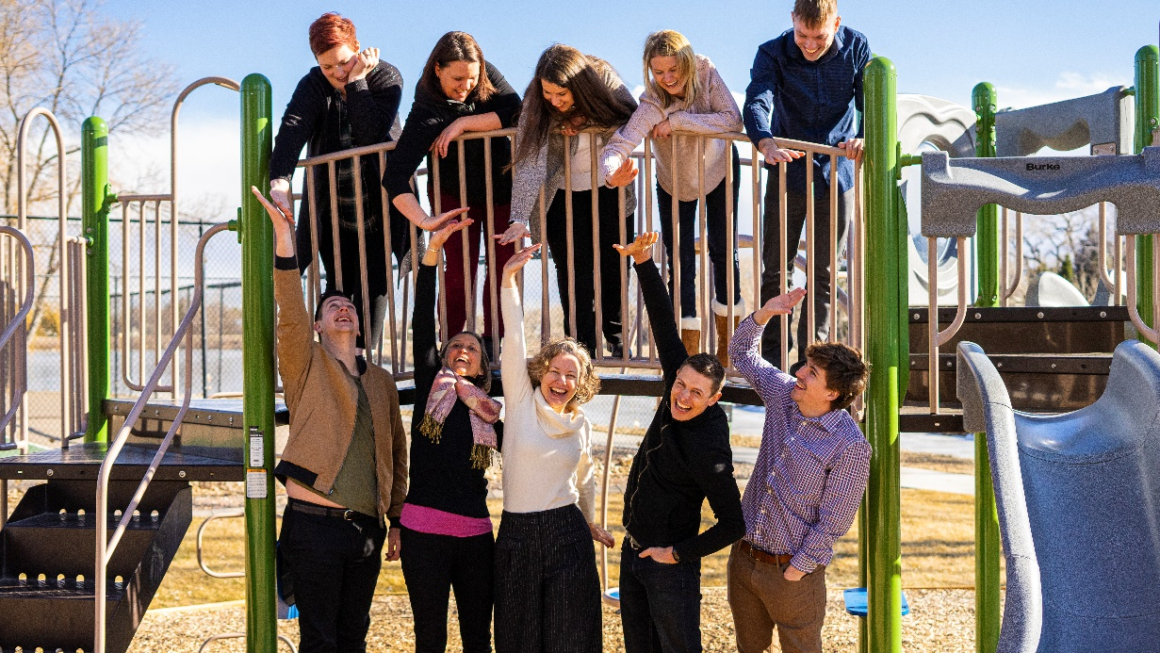
We are a social enterprise with a mission to help people leverage network science to strengthen supportive connections and improve the outcomes of their work.
We provide:
Technology-based data and mapping tools
Learning as Trainings and Workshops
Opportunities for collaborative innovation

Slide 3


Make Invisible
Networks Visible

Slide 4
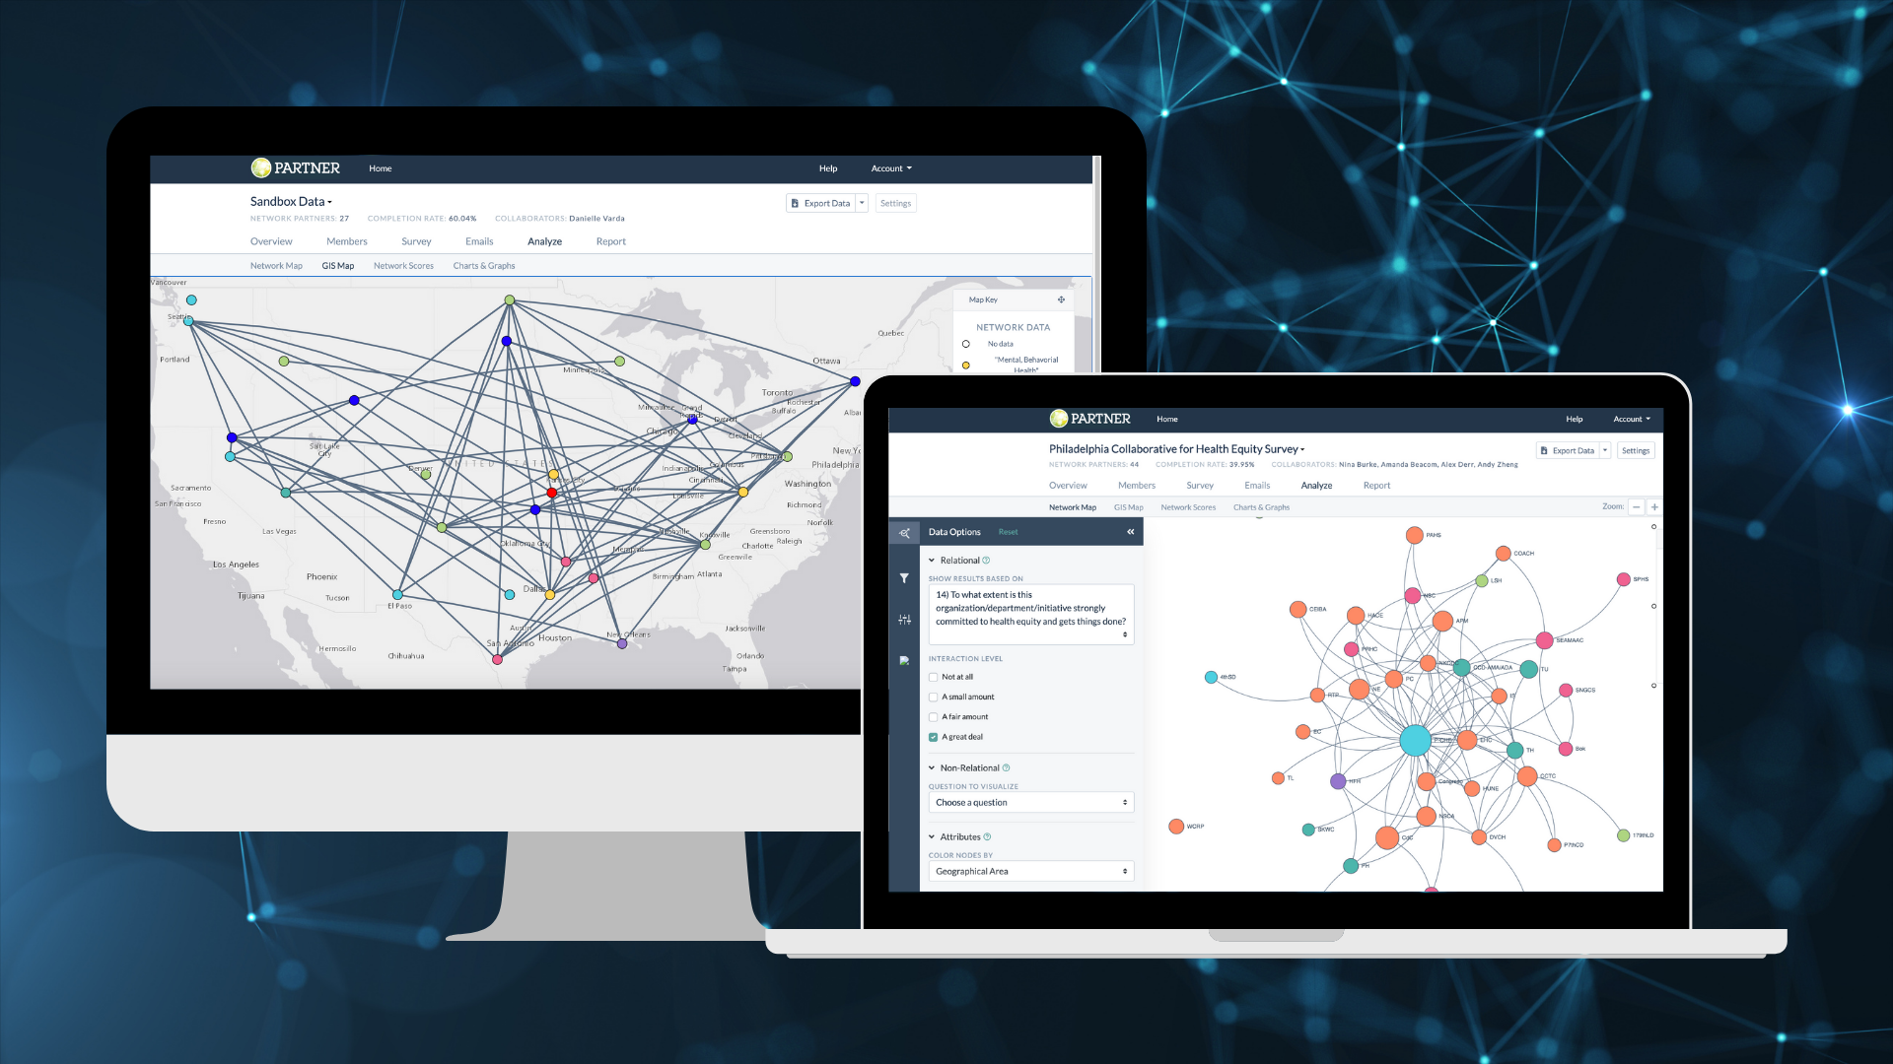


Slide 5
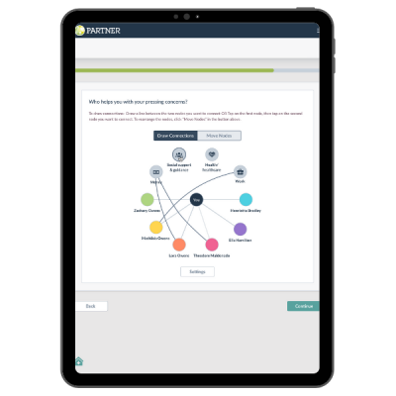
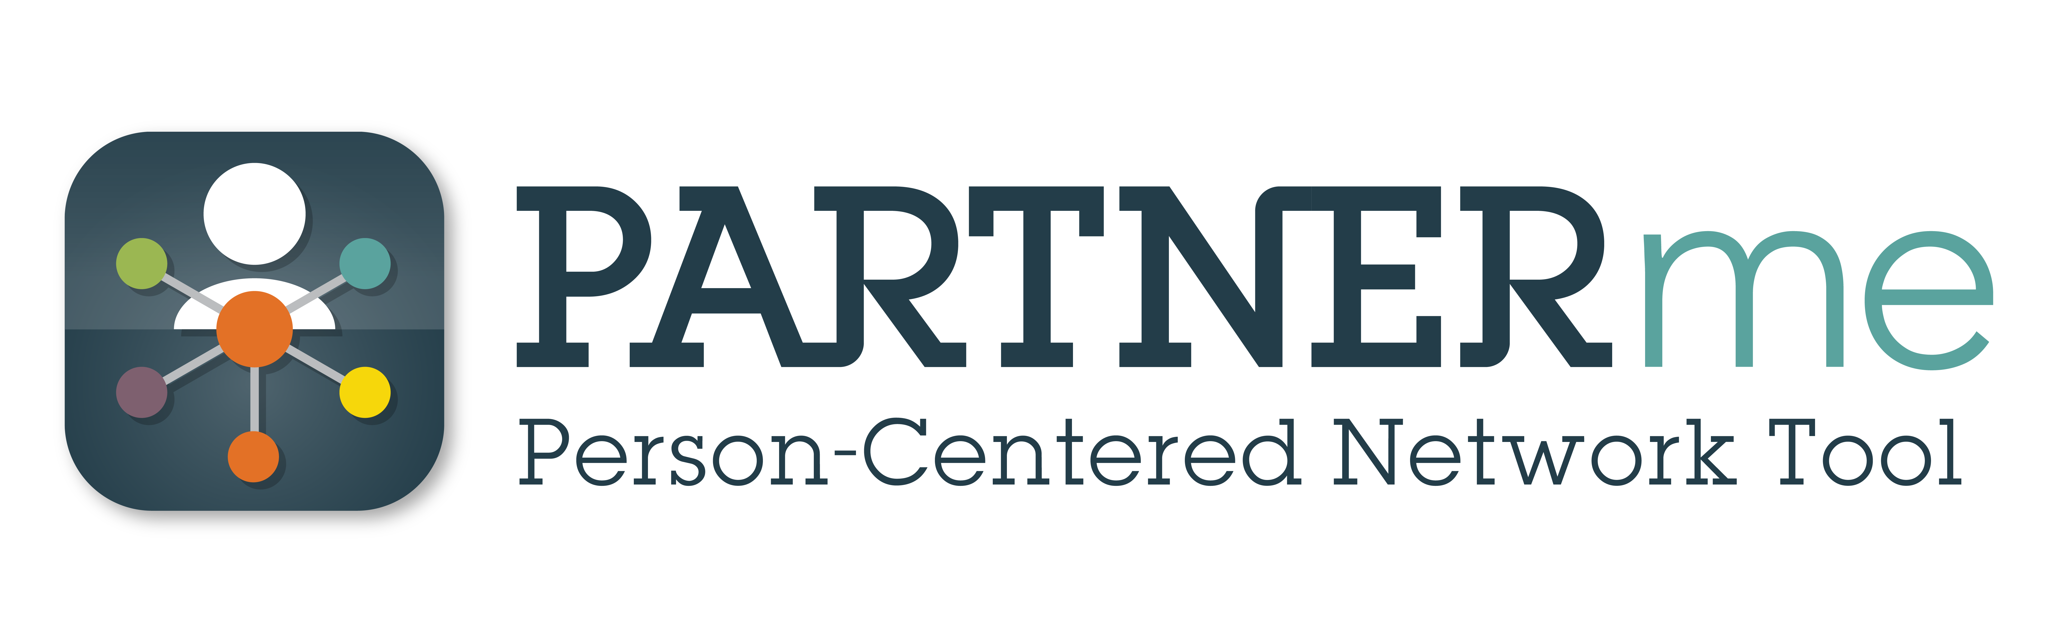
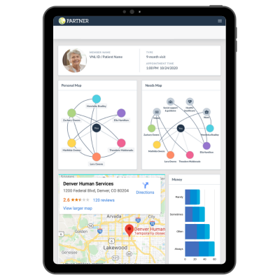
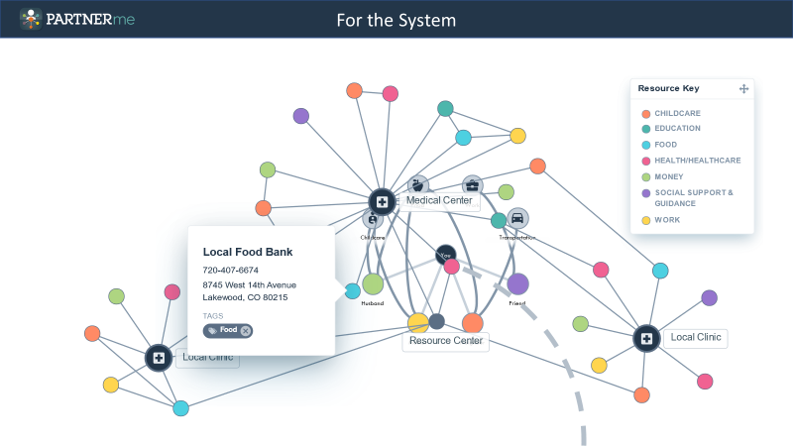
Social Needs/Social Connectedness Screener to Link People to Resources
www.visiblenetworklabs.com/partnerme

Slide 6


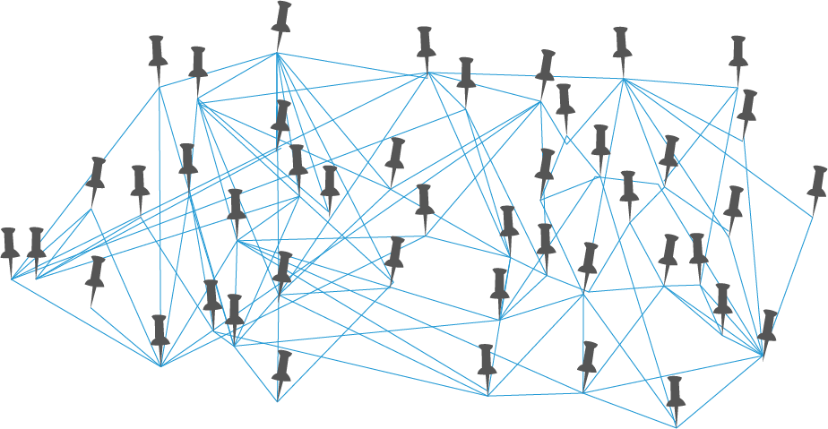



The New Norm:
The Network Way of Working

Slide 7

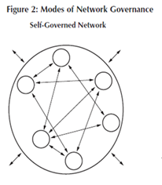
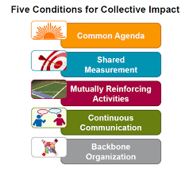
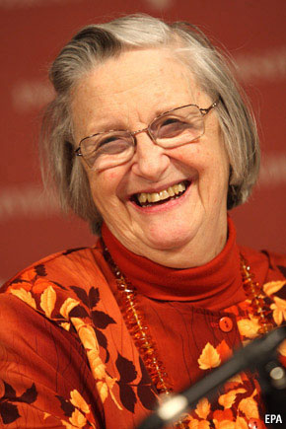
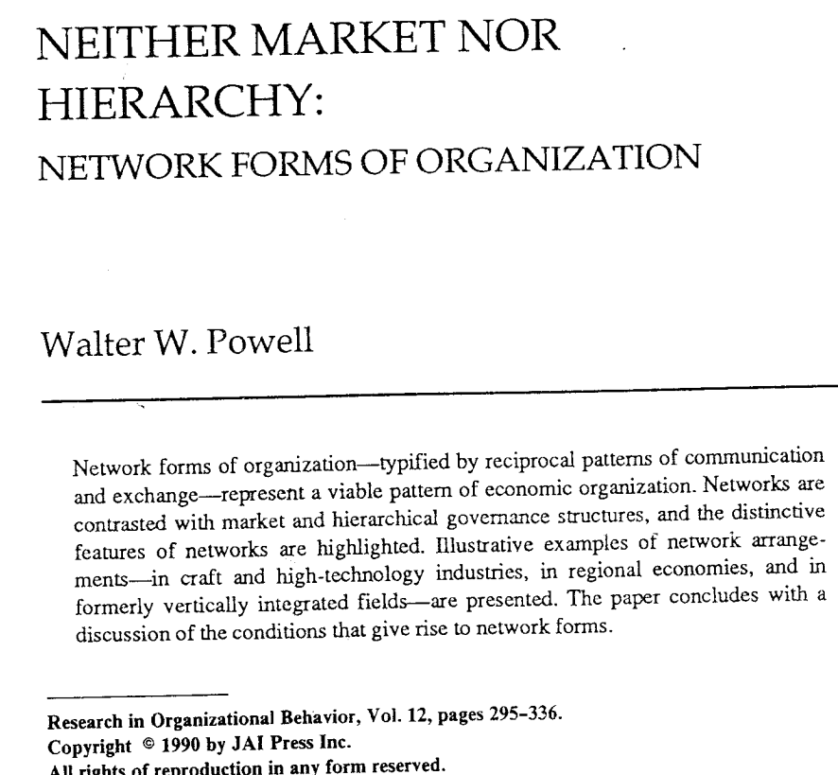

The Growth of Networks

Slide 8
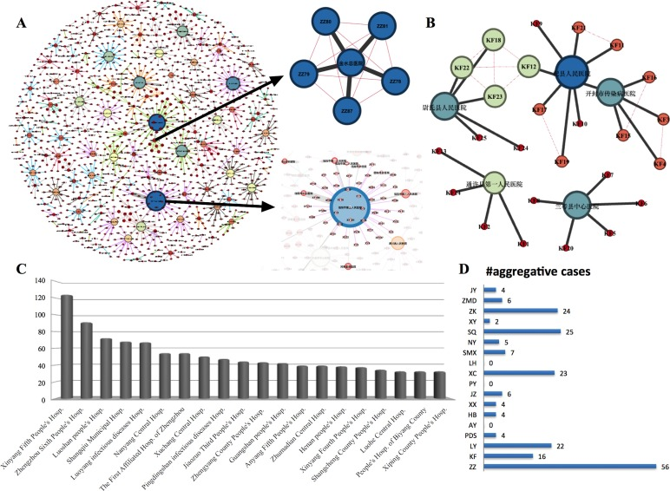
COVID Made Us All Network Scientists
Overnight, everyone on the planet had to develop a “network strategy”
  Who can/should I connect to?
  What is the cost/benefit of each connection?
  How do I develop a closed, efficient network?
  When is the risk of expanding my network worth the rewards?

Slide 9
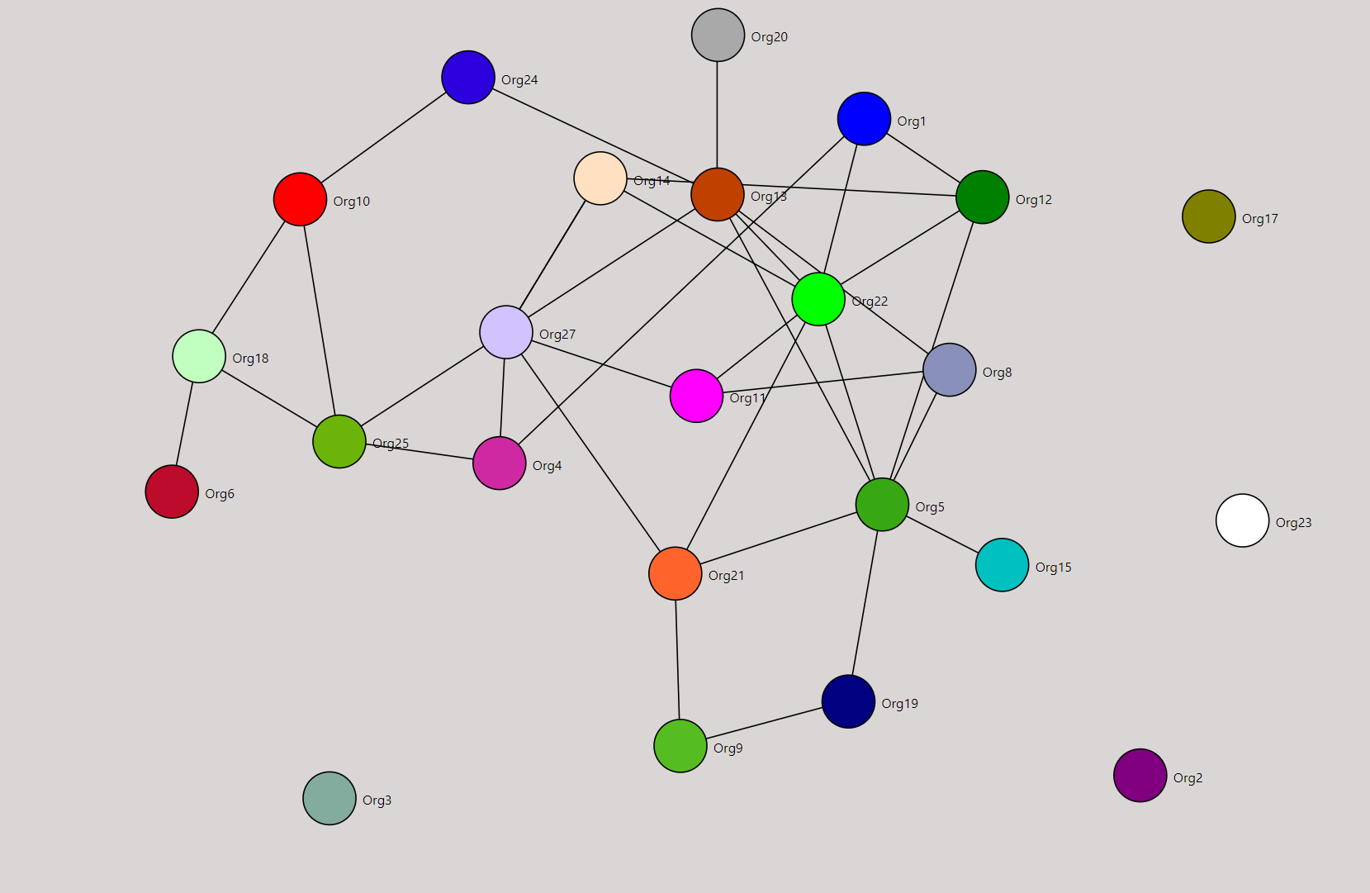
What Are Networks?
Nodes:
Organizations, People
Relationships Between the Nodes
Notes:
A group of 3+ organizations working toward a common purpose
Trust, reciprocity, and negotiation replace the chain of command
Non-hierarchical, but they have a structure
Many types of connections (contracts, referrals, information, and joint projects) hold networks of organizations together
May be emergent or mandated
People represent organizations at the network table

Slide 10
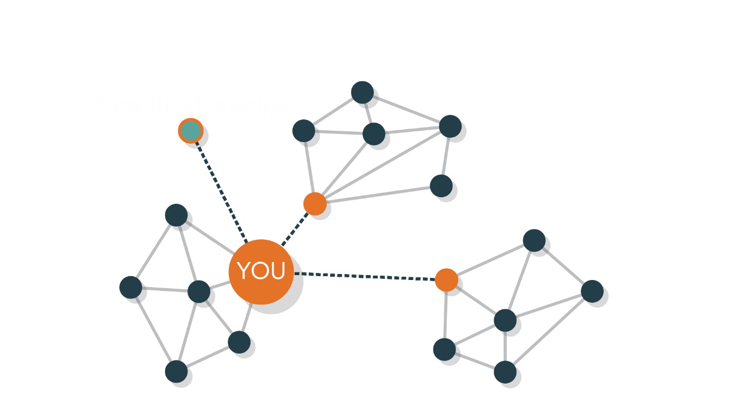
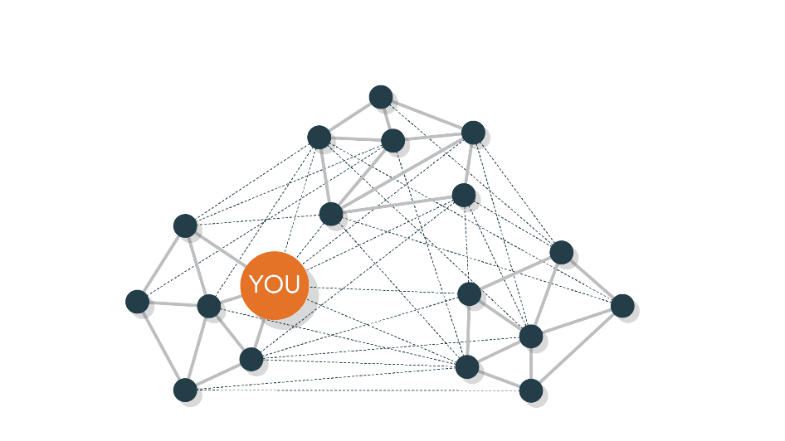
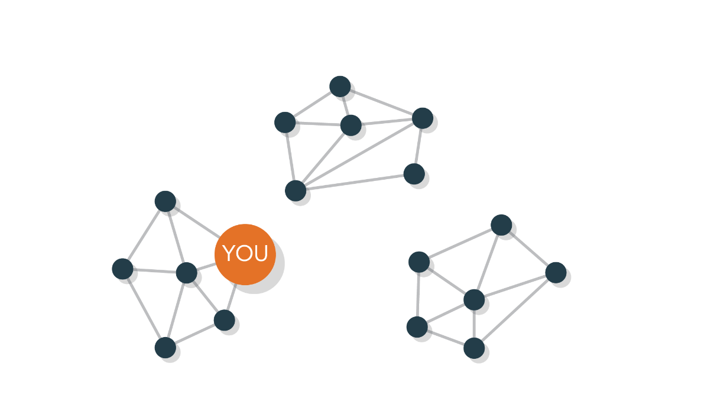
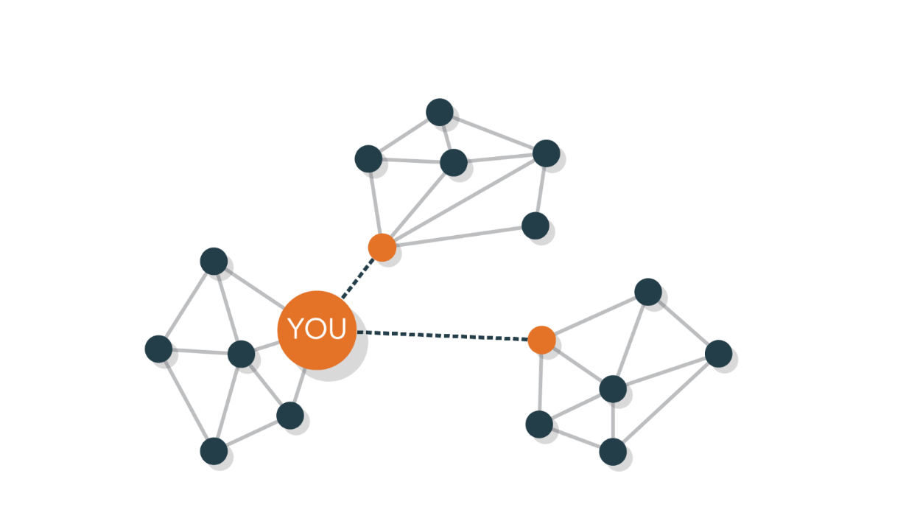
Network Science as a Unique Lens
Basic Network Science Principle: More is Not (Always) Better
You can manage relationships to create a network strategy,
but you need data to do it.

Slide 11

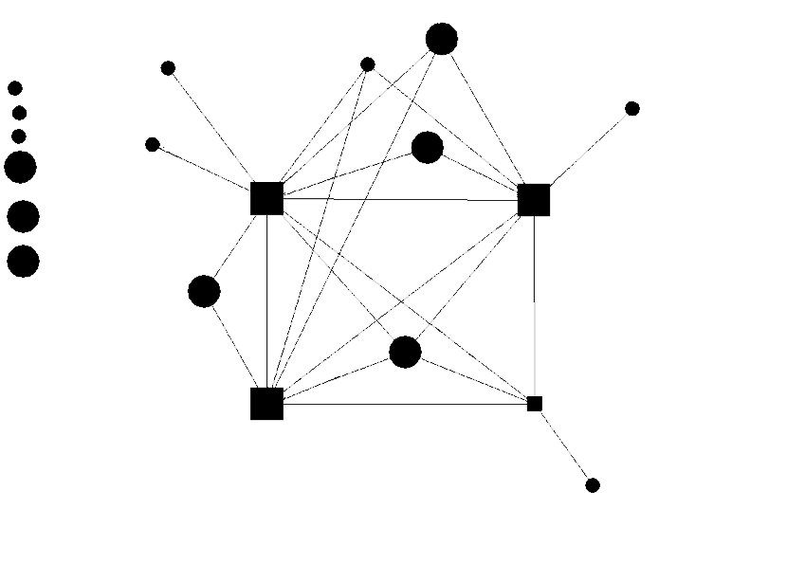
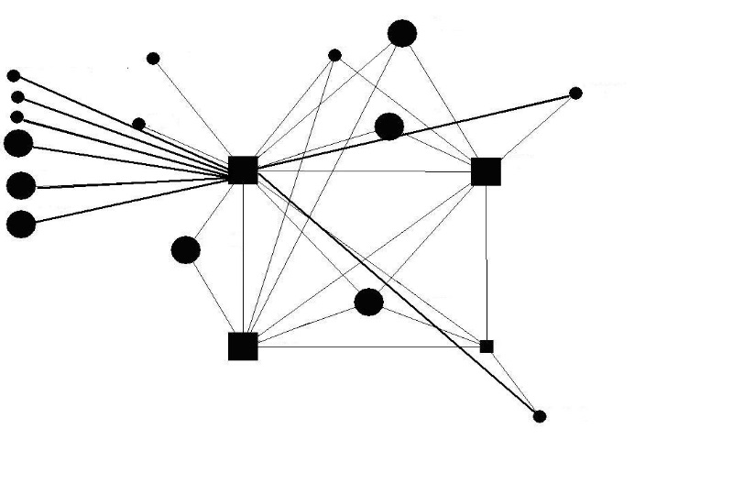

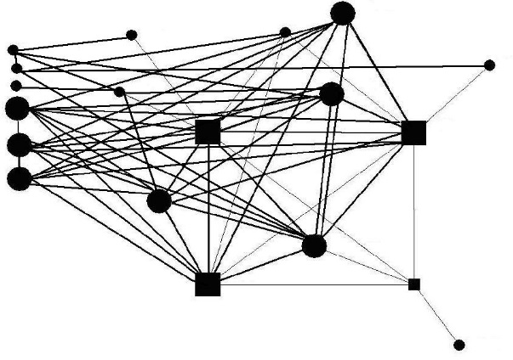
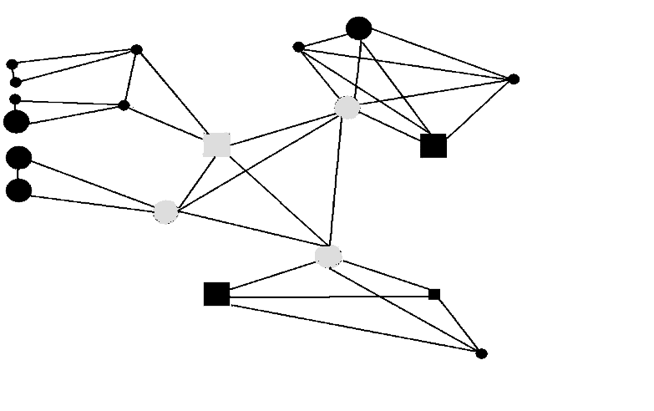
Lifecyle of a Sustainable Network
Phase 1:
Creating Network Ties
Phase 2:
Connecting the Network: No Isolates
Phase 4:
Creating Subgroups
Phase 3:
Growing the Network
Notes:
In this model, we allow science-based data and analytics to address ROI and inform strategy direction
And we do it in a way that incorporates all the qualitative measures that really drive our collaborative relationships
It’s the best of both worlds: Science that honors our humanness.
Let me give you a real-world example…

Slide 12
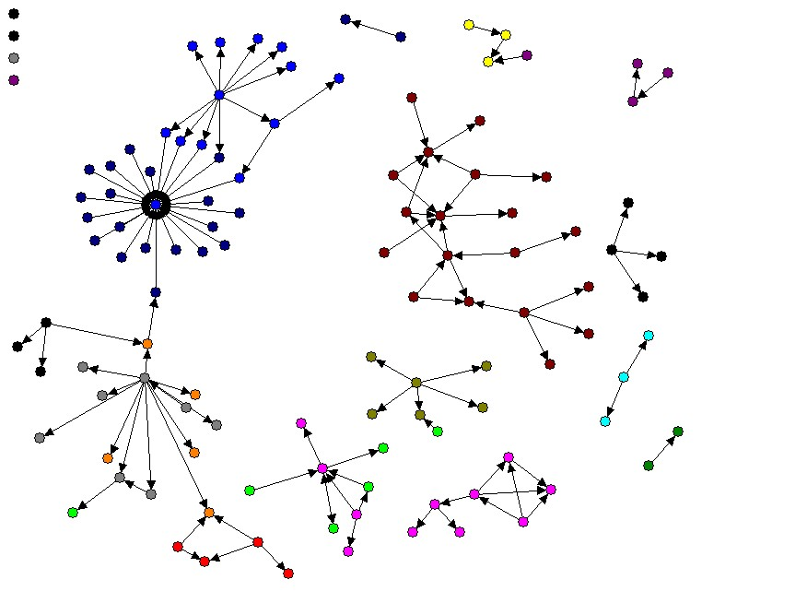
Network Science in Real Life
Planning a Wedding…
Notes:
In this model, we allow science-based data and analytics to address ROI and inform strategy direction
And we do it in a way that incorporates all the qualitative measures that really drive our collaborative relationships
It’s the best of both worlds: Science that honors our humanness.
Let me give you a real-world example…

Slide 13
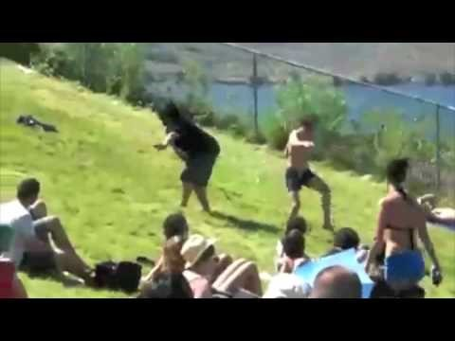

Slide 14

Main Take Aways
Building and managing a network doesn’t have to be left to chance – there is a science to help guide you.
You are already a network scientist. You use network science every day.
You can manage network relationships to develop a strategy, but you need data to do it.
More networking is not better networking.
You can identify redundancy and holes in your network, which can inform the strategy.
A proven strategy for network sustainability:
  Everyone in the network has a role they understand.
  Participation only required when that role is needed; otherwise its optional.
  The network has a stated goal that the end includes a strategy to use the fewest number of resources to reach the same collaborative advantage.

Slide 15
Network Measures and Evaluation
Notes:
In this model, we allow science-based data and analytics to address ROI and inform strategy direction
And we do it in a way that incorporates all the qualitative measures that really drive our collaborative relationships
It’s the best of both worlds: Science that honors our humanness.
Let me give you a real-world example…

Slide 16
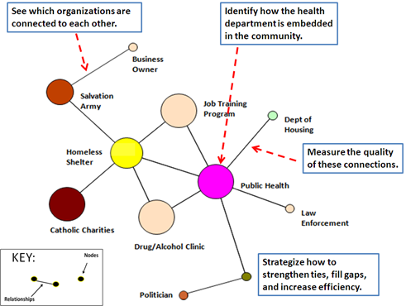
Network Evaluation
Evaluate how well your network is working in terms of identifying essential partners and gauge their level of involvement, leveraging resources, and strategizing for how to improve the work of the collaborative.
Demonstrate to partners, stakeholders, evaluators, and funders how your collaborative is progressing over time and why working together is making tangible change.

Slide 17
Network Evaluation Framework
Network (Systems) outcomes are different from population or client outcomes; Rather, intermediary outcomes that reflect the way that organizations interact, share resources, and implement work (Process Outcomes)
Social Network Analysis; Qual; Quant
Connections for Systems Building
Network Outcomes
Perceptions of:
- Value, Trust, Authenticity
- Goals, Outcomes, Process
Measures of:
- Key Positioning,
Coordination, Efficiency,
Redundancy
[Among People/Orgs]
[Set in Various Context]
Teacher Preparedness Outcomes
Convening Stakeholders
Needs Assessments
Leveraging Resources
How can I use this information to manage this system?

Slide 18
Example Network Evaluation Questions
How should organizations invest resources to build and strengthen new partnerships?
How are cross-sector partnerships leading to health and well-being outcomes?
Which sectors are already working together and where there are gaps?
How does involvement in learning networks affect how participating institutions think and act?
What kinds of resources are organizations leveraging collaboratively?
How do different sectors report perceptions of one another in terms of value and trust?
What are the gaps and opportunities that exist?
What are strategizes for how to leverage existing relationships?

Slide 19
Considerations in Network Measurement
Notes:
In this model, we allow science-based data and analytics to address ROI and inform strategy direction
And we do it in a way that incorporates all the qualitative measures that really drive our collaborative relationships
It’s the best of both worlds: Science that honors our humanness.
Let me give you a real-world example…

Slide 20
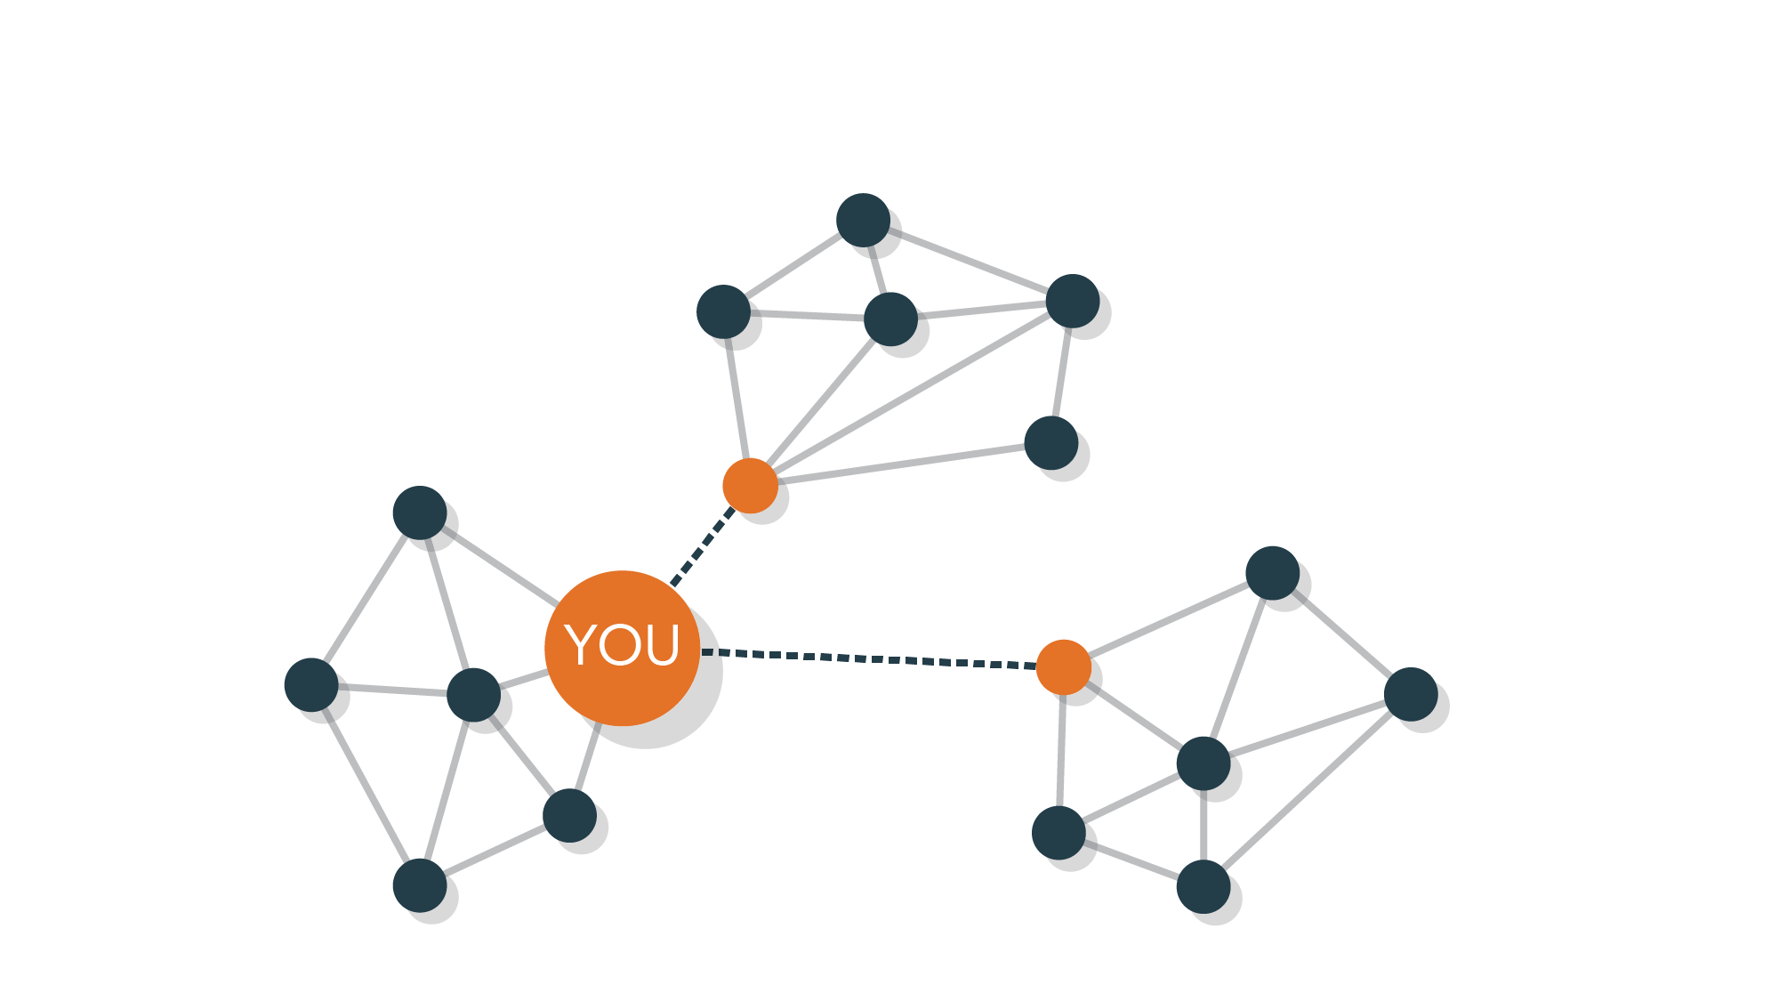
Data
Tracking
Notes:
Most people will tell you you need some sort of data process.
But here’s the thing with data, what you are able to get out of it completely depends on what goes into it.
And that’s where our methodology is really revolutionary.

Slide 21




Quant & Qual Measures
Notes:
These are not just nodes and lines driving the network science.
That’s a significant part of it, but we that every one of these connections is rooted in human and relationships

Slide 22
PARTNER Evaluation Framework
Meaning in the Relationships
Interrelationships:
The structure of how network members are connected
Contribution:
Explaining the Formation and Evolution of Ties
Perceptions:
Understanding how members perceive relationships such as value of partnering
Agreement:
The degree to which network members are “on the same page”
Perceptions of Trust and Value
Process Quality Working Together Scale
Attribution/Contribution to the Larger Systems Outcomes
Success, Outcomes, and Change Over Time

Slide 23
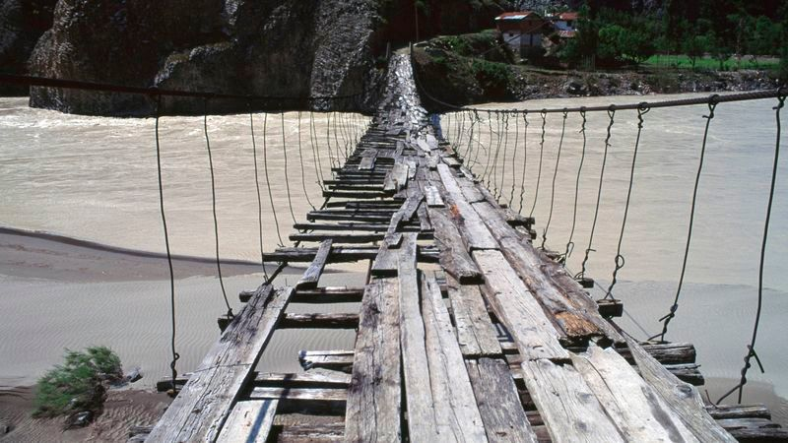

Slide 24
A Couple Concepts in
Social Network Analysis
Notes:
In this model, we allow science-based data and analytics to address ROI and inform strategy direction
And we do it in a way that incorporates all the qualitative measures that really drive our collaborative relationships
It’s the best of both worlds: Science that honors our humanness.
Let me give you a real-world example…

Slide 25
2 Different Network Approaches
Whole Network
A complete set of bounded actors
Example: All members in a tobacco coalition, all public health departments in the country, all clients in a health delivery network
Ego/Personal Network
Randomly sample people from a population
Ask only about their alters (no roster)
Ask a sample of patients about who the members of their personal support network are

Slide 26
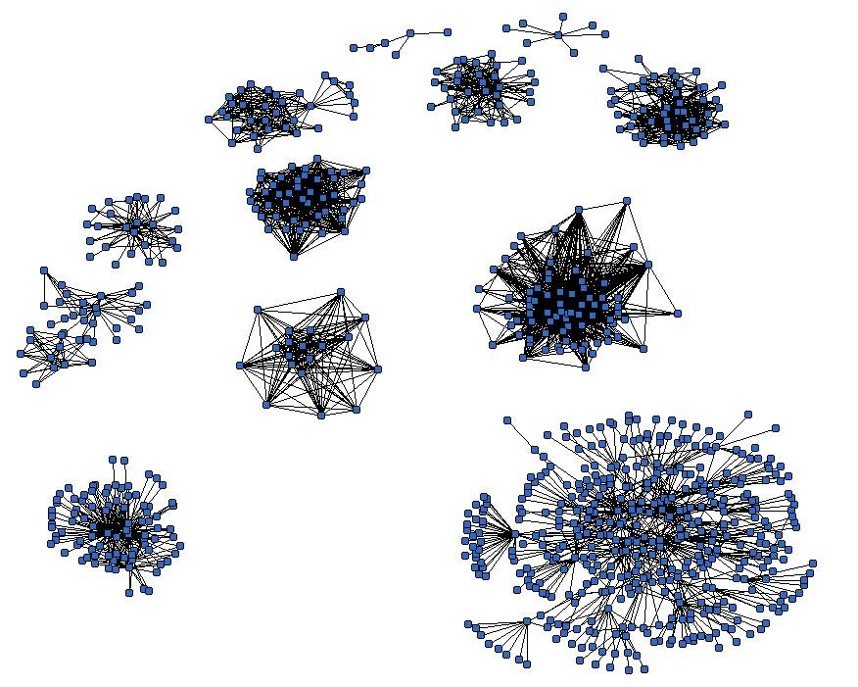
Unit of Analysis: Whole/Sociocentric Level
Networks Vary in Size, Shape, and Composition

Slide 27
Unit of Analysis: Subgroup Level
Subgroups are a subset of the graph based on certain nodes or links

Slide 28



Unit of Analysis: Dyads/Triads

Slide 29

Unit of Analysis: Individual Nodes (Ego-Centric)

Slide 30
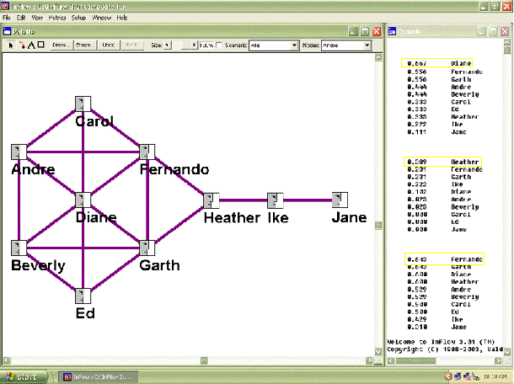
Measures to Describe Networks
Degree
In-Degree
Out-Degree
Centrality

Slide 31
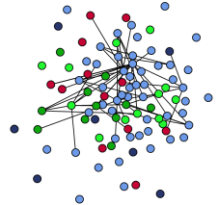
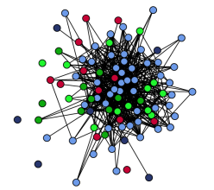
Density
High Density Low Density

Slide 32
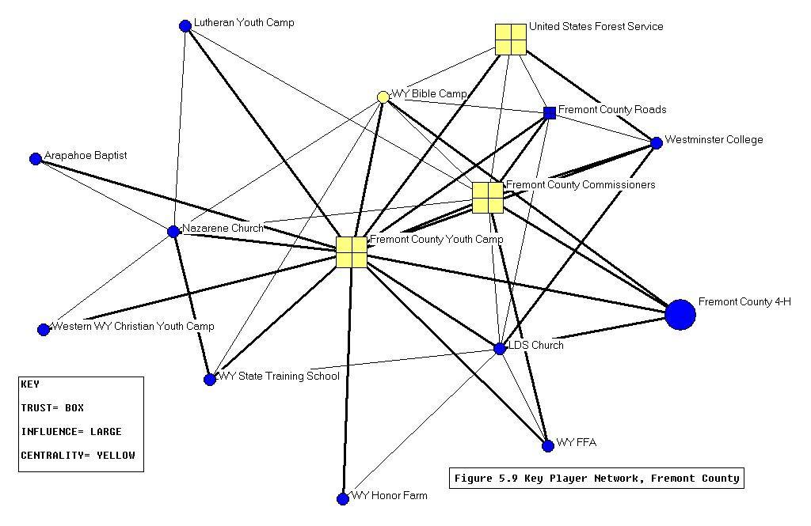
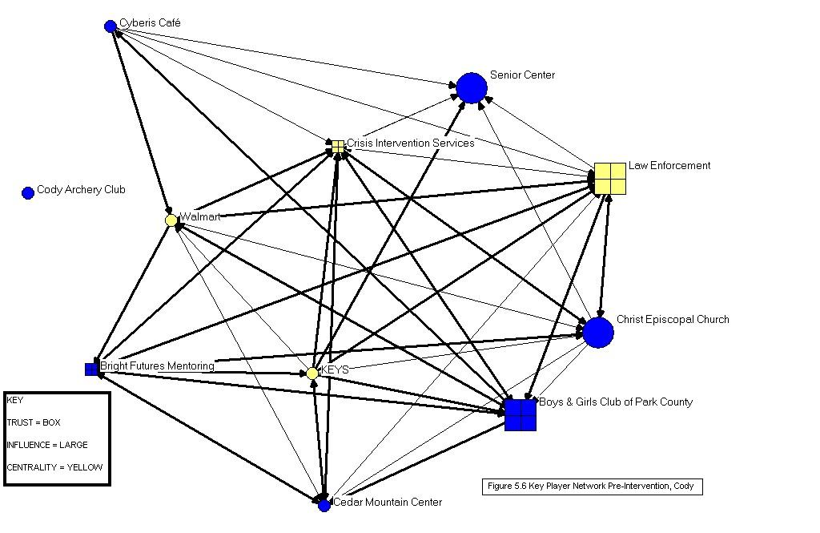
Centralization
Extent to which a network revolves around a single node
Most networks start out centralized, become decentralized over time

Slide 33
Examples of
Network Evaluation and Metrics in Action
Notes:
In this model, we allow science-based data and analytics to address ROI and inform strategy direction
And we do it in a way that incorporates all the qualitative measures that really drive our collaborative relationships
It’s the best of both worlds: Science that honors our humanness.
Let me give you a real-world example…

Slide 34
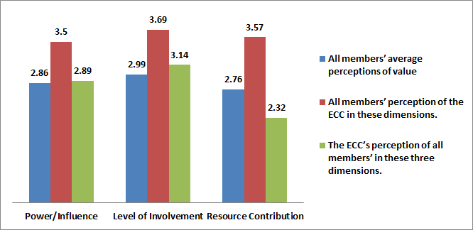
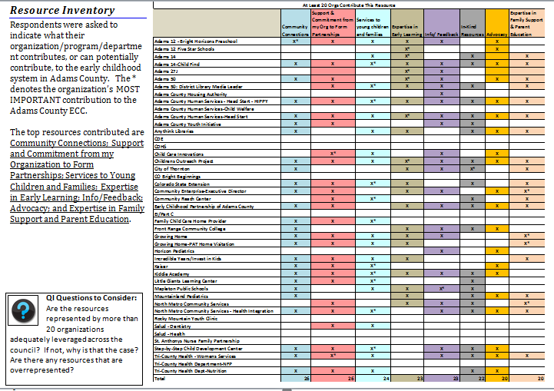
ECC Coordinator Indicated Lower Perceptions of Resource Contribution
Questions to Consider
What types of resources, time, and power/influence would be most helpful for this work?
Does enough exist?
Are there specific orgs we can target to improve his score?
Potential Strategies
More is not better, so…this might be ok and we don’t need to do anything.
Network manager can look to list of resources and target specific organizations to contribute those resources.

Slide 35
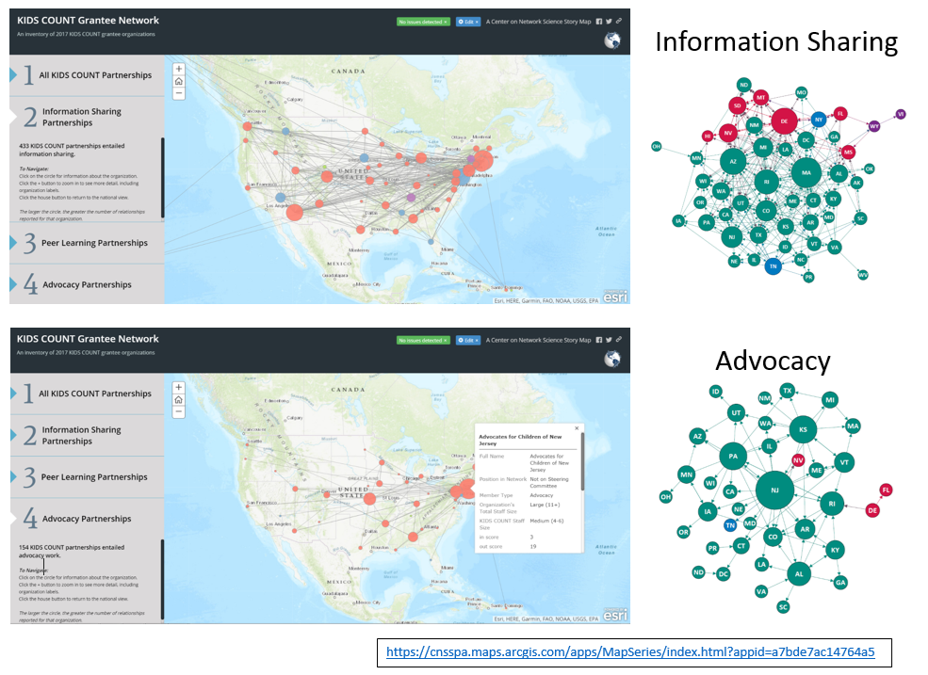
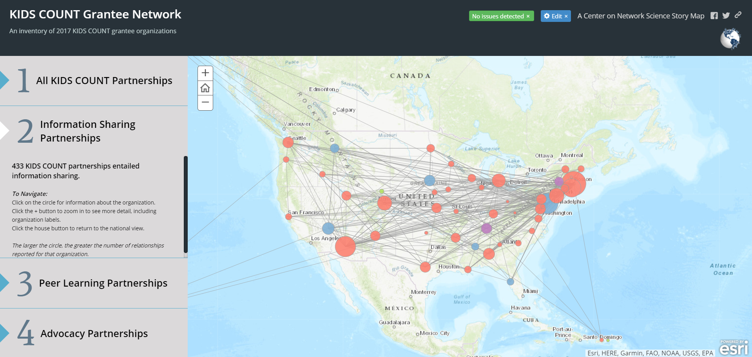
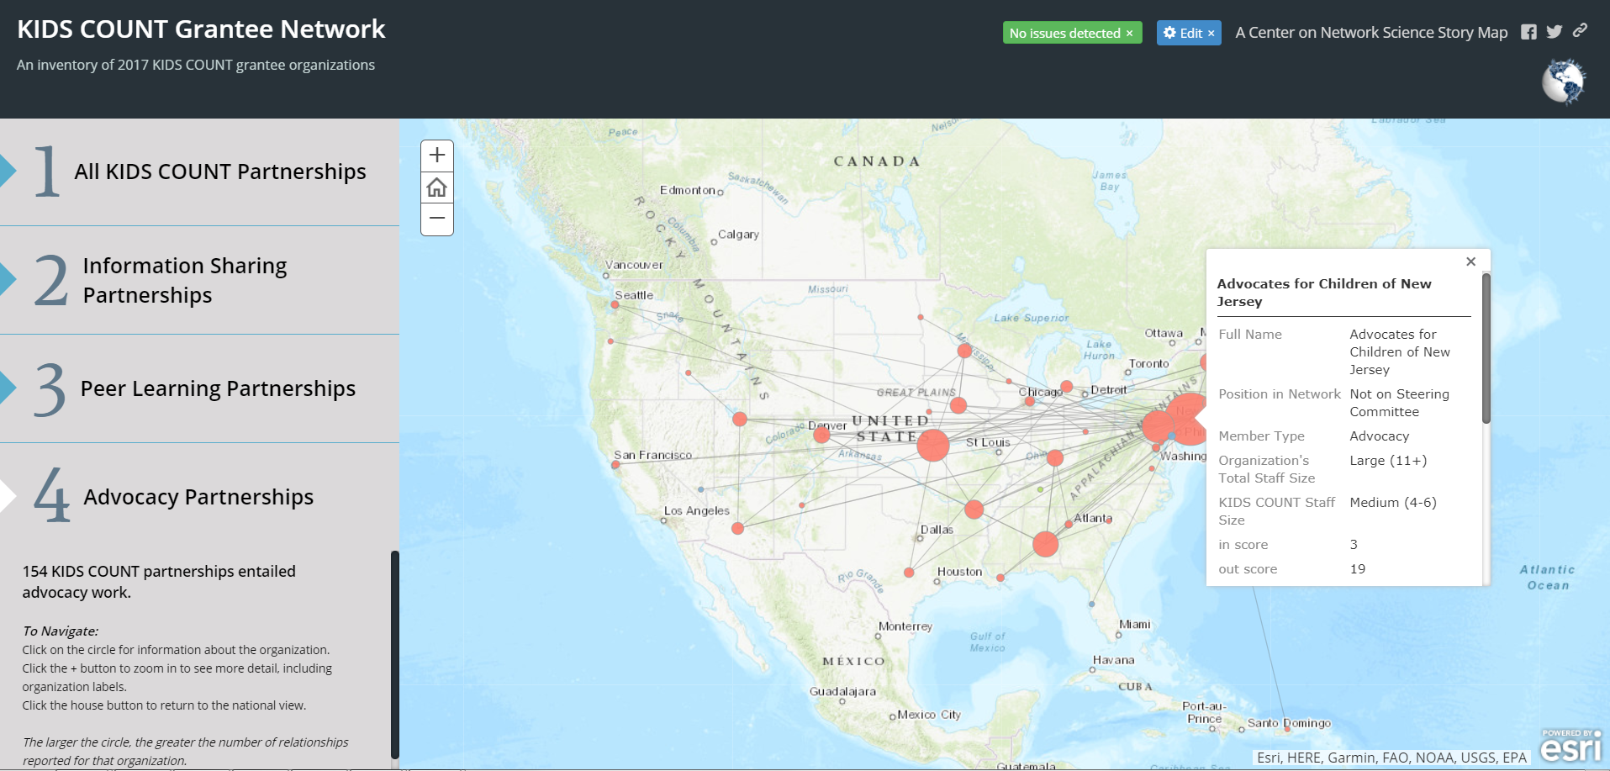
Assessing ROI on Network Investment
By Showing Reach and Depth
Example Network
Example Network

Slide 36
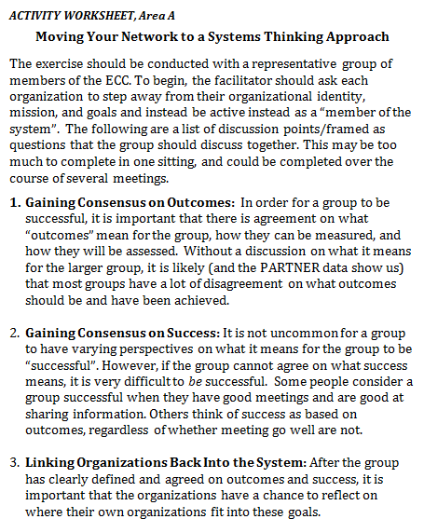
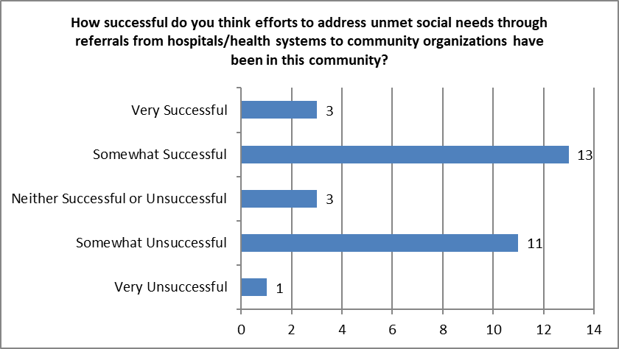
Questions to Consider
Does the network have a common definition of success?
What are the differences between the groups and how they answered?
Can these results be improved?
Potential Strategies
Have a discussion about success!
Develop goals that map on to definitions of success.
Link organizations back to the outcomes and definitions of success.

Slide 37
Questions
Notes:
In this model, we allow science-based data and analytics to address ROI and inform strategy direction
And we do it in a way that incorporates all the qualitative measures that really drive our collaborative relationships
It’s the best of both worlds: Science that honors our humanness.
Let me give you a real-world example…

Slide 38
WONDERbabies
Partnerships for Health Initiative
With funding from The Colorado Trust

Slide 39
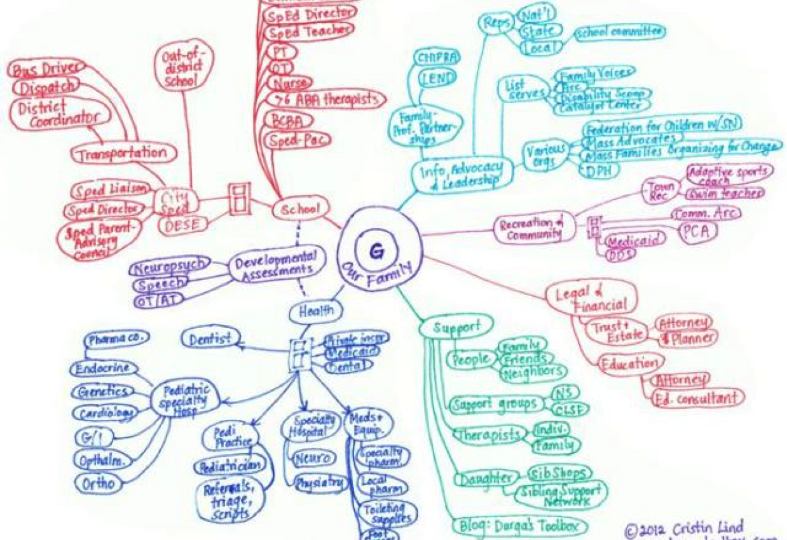

Slide 40
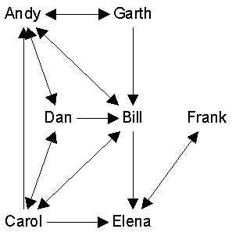
Social Network Analysis
Collects data on who is connected to whom
How those connections vary and change
Focus on patterns of relations
Type, Extent, Quality of Connections
Nodes (People, Orgs, Etc)
Lines (Relationships)
1
1
3
2
3
2
1
3
2
1
2

Slide 41
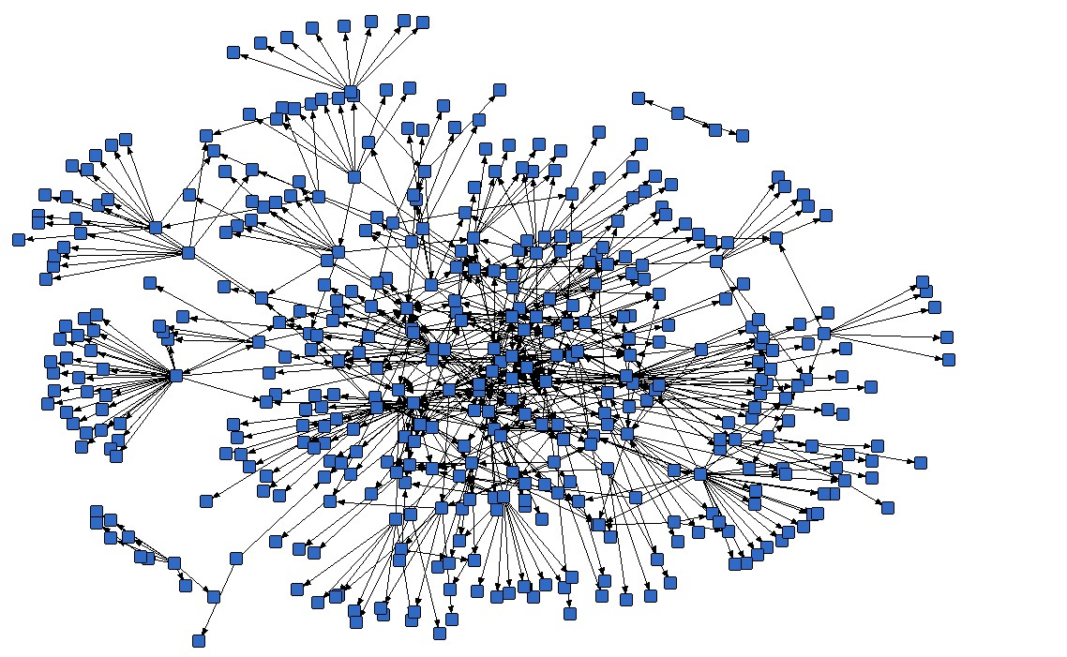
System of Care for Babies & Young Children With Special Healthcare & Developmental Needs
723 Partnerships
450 Organizations

Slide 42
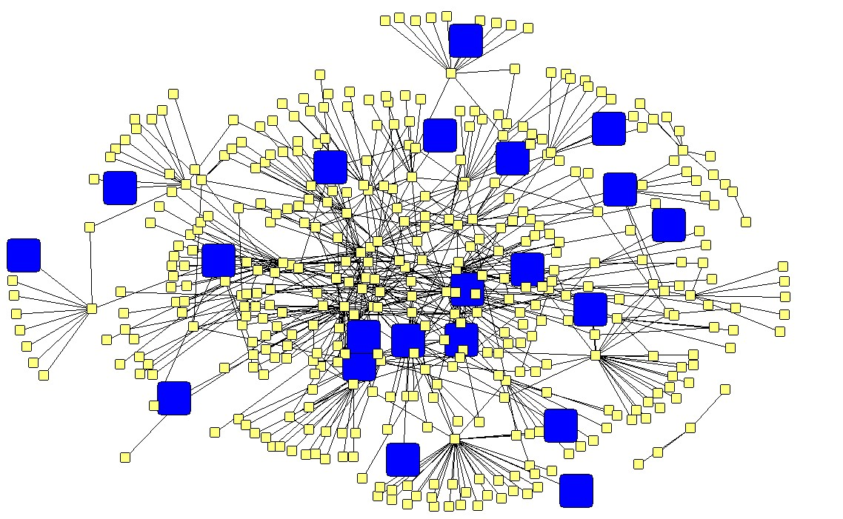
Mental Health Agencies:
Geographically Disperse but not Connected to Each Other

Slide 43
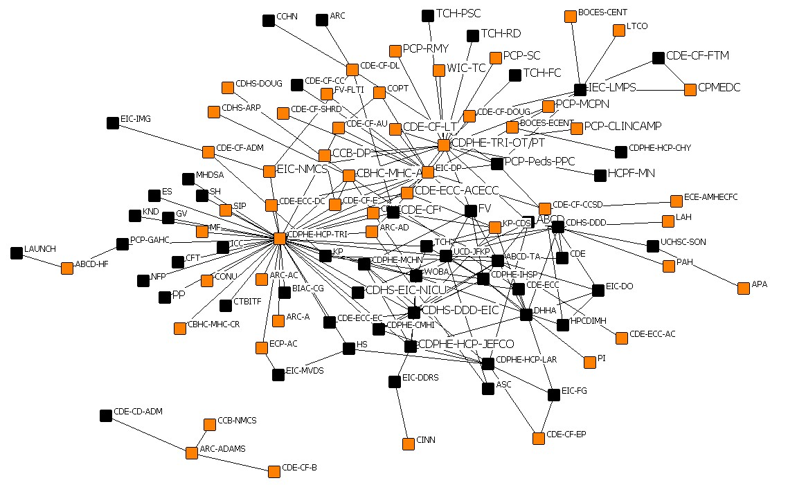
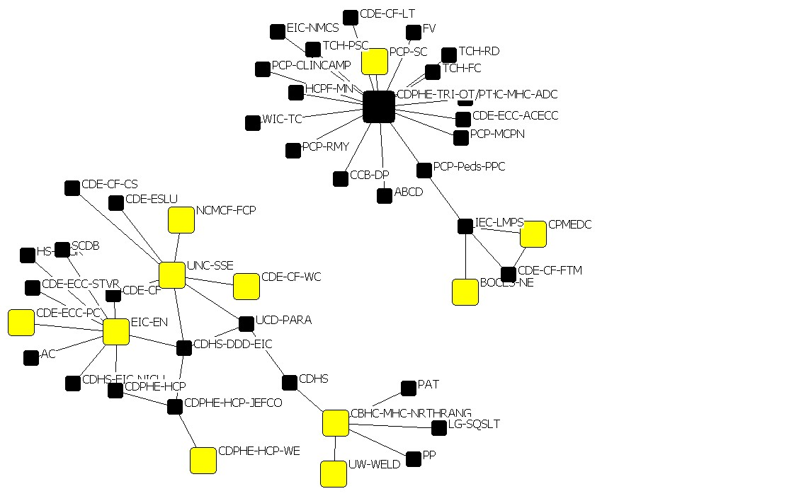
County Level Look at the Data Shows Lots of Variation
Adams/Arapahoe/Douglas Weld

Slide 44
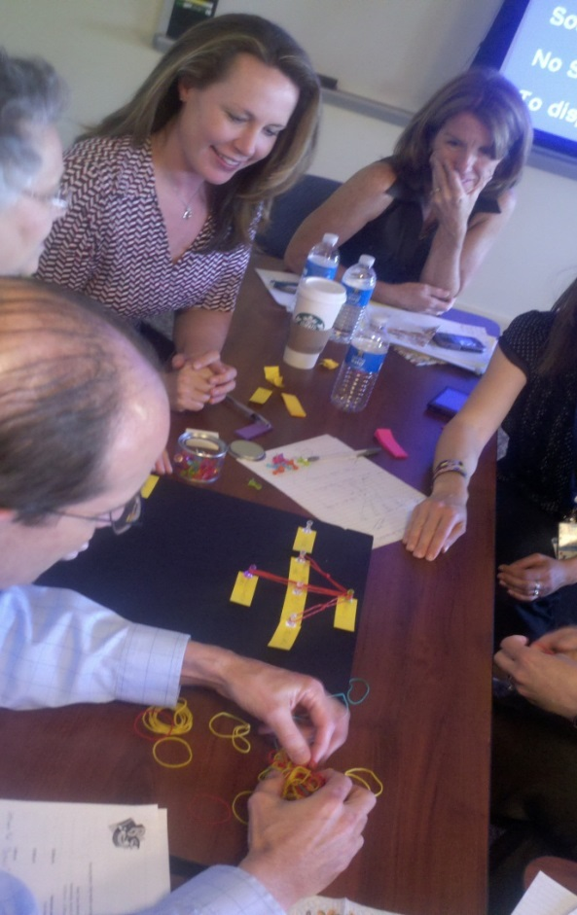
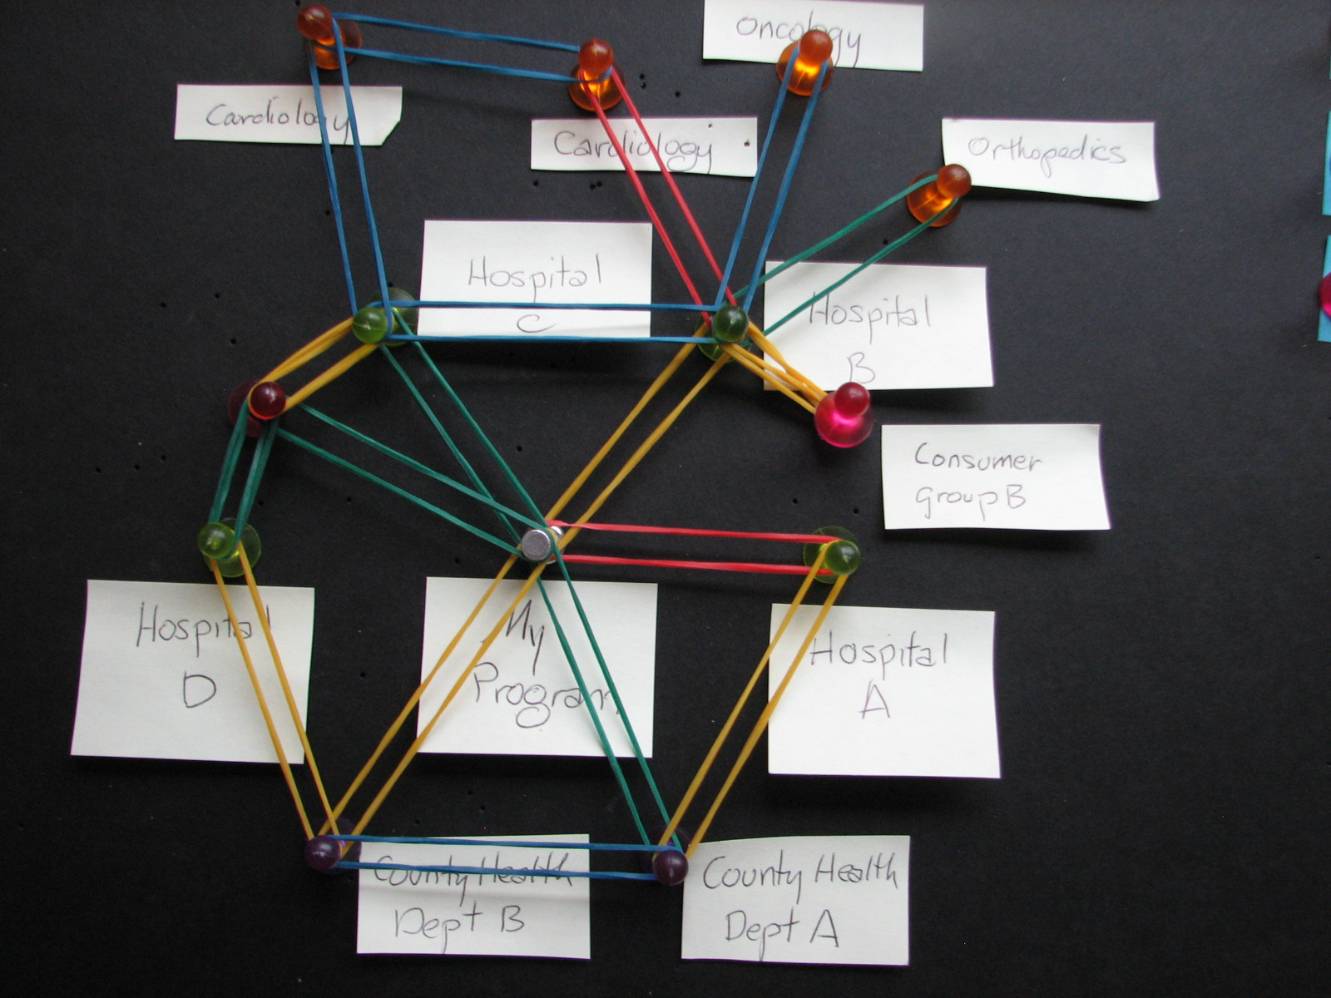

Slide 45
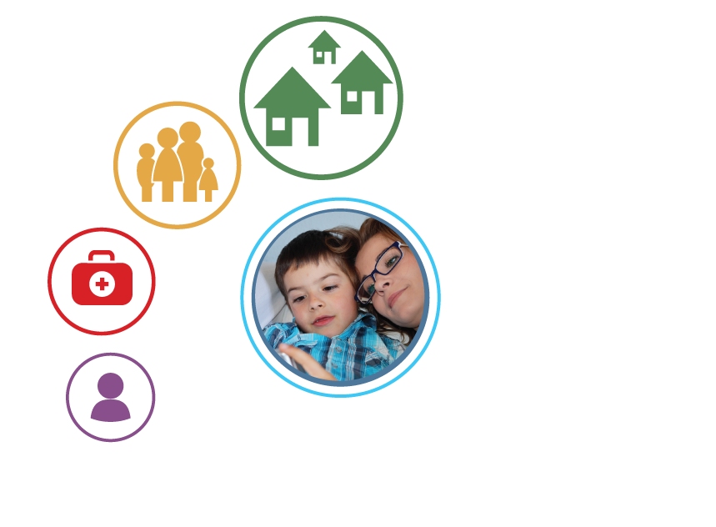


Slide 46
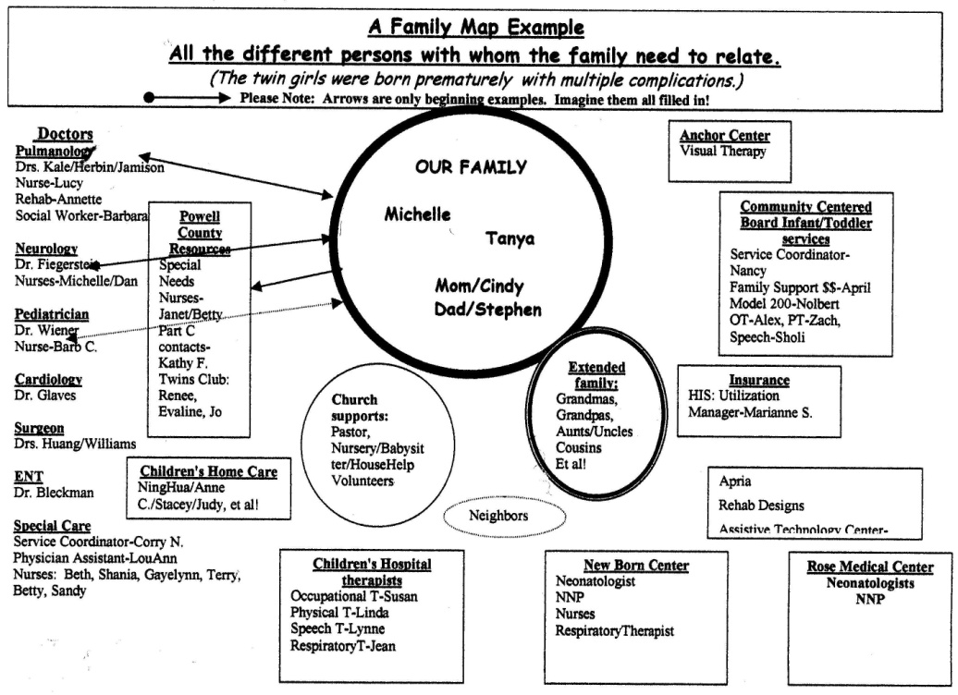
Family Blueprint Shows
a Fragmented System

Slide 47
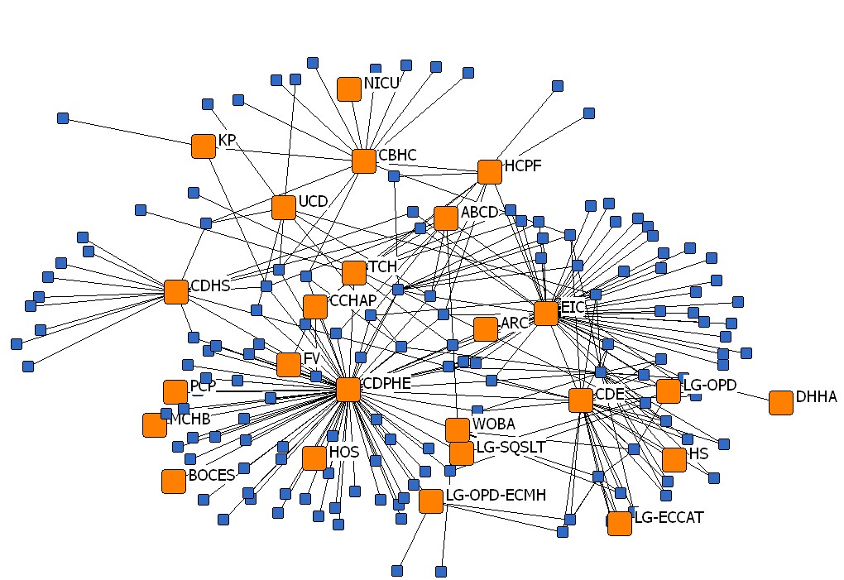

Systems vs. Family Networks
1 – Families have a preference for tapping into their informal supports for help first; then they will use the system when that’s not enough.
2 – People want to help themselves…they want to be resilient, not dependent or a burden.
FAMILY NETWORKS
SYSTEM NETWORK

Slide 48
This is Interesting –
But Can We Use This to Help People?
Question: Why do we expect people to fit into the system? Why don’t we expect the system to fit around people?
Hypothesis: If the system is coordinated, then this is reflected in the personal networks of families.
Outcome Measure: When 100% of families say their personal networks are coordinated, then we know the system is working.
First
Understand personal support networks and needs
Then
Build an adaptive system to respond to variations

Slide 49


Slide 50






Slide 51

Screener
Please rate your own health?
Bad Health
Good Health
How often do you feel lonely?
Rarely
Often
Who do you rely on when you have problems?
Doctor
Mother
You
To what degree do you trust this person to help you when you need it?
To what degree do you depend on them?
Neighbor
Friend

Slide 52
Screener
Childcare
Education
Emergency needs
Health/healthcare
What are your most pressing concerns?
Food
Housing & Utilities
Legal matters
Mental/behavioral health
Money
Social support and guidance
Transportation
Work

Slide 53




Screener
Food
Work
Who helps you with these concerns?
Childcare
Transportation
You
Doctor
Friend
Mother
Neighbor

Slide 54
For Providers
Food
Work
Doctor
Mother
Childcare
Transportation
You
You
Doctor
Friend
Neighbor
Friend
Mother
Neighbor

Slide 55
Food
Work
Husband
Mother
Childcare
Transportation
You
You
For Providers
Husband
Friend
Neighbor
Friend
Mother
Neighbor

Slide 56
Husband
Mother
You
Neighbor
Friend
For Patients

Slide 57
Food
Work
Husband
Mother
Childcare
Transportation
You
You
Husband
Friend
Neighbor
Friend
Mother
Neighbor
For Patients
Food
Work
Childcare
Transportation
You
Husband
Friend
Mother
Neighbor

Slide 58



For the System
Food
Work
Childcare
Transportation
You
Husband
Friend
Mother
Neighbor

Slide 59



Slide 60







We are also discovering the other ways we can apply this – for kids!

Slide 61

Questions/Ideas?
danielle@visiblenetworklabs.com
www.visiblenetworklabs.com

Slide 63


Permission to Play…

Slide 64

Mapping Your Personal Network

Slide 65

Start with the one member..

Slide 66

Use a push pin to represent each member of the network. Show these on a color key located on the upper right hand side of your board.
Examples
Green = Friends
Orange = Family
Purple = Co Workers
Red = Community Orgs

Slide 67

    Each stakeholders relates
    to each other with a different type of tie. Ties are shown with different colored rubber bands.
  Use the rubber bands to represent ties in your network.
    Example: Blue: Ties to Families
    Red: Advice Sharing
    Yellow: Emotional Connections
    Green: Shared Responsibility
SCALE OF INTEGRATION (examples)

Slide 68

Examples of how members might be connected to one another. (Directly)

Slide 69

Examples of how members might be connected to one another. (Indirectly)

Slide 70
Examples of how stakeholders might be connected to one another. (Indirectly)

Slide 71

Mapping Your Personal Network

Slide 72




…now you try it.

Slide 73


A map of the First 2000 Days network
Core Group With Most Connections
Key:
Periphery Partners

Slide 74
ORGANIZATIONAL: There has been an improvement in the strength of relationships comparing cohort 1 and cohort 2 of the Strengthening Families COLLECTIVE
Cohort 1
Cohort 2

Slide 75
First 2000 Days Progress Towards Achieving Goals
The most common goals that individuals said First 2000 Days has made progress towards over the past two years are:
  91%
  Support capacity building among Network participants
  84%
  Identify and act on opportunities for collaboration and collective action
  84%
  Connect existing early childhood development initiatives to better coordinate actions and share learnings
“It’s built my capacity to understand approaches to supporting meaningful learning with others, capacity building processes, and strategies to support collective action and behaviour change among different types of stakeholders.” –Backbone

