Slide 1
What determines health, who builds the network? June 20, 2019 some musings with the folks and friends of Visible Network Labs
Peter Eckart, Director
Illinois Public Health Institute
Data Across Sectors for Health (DASH)

Slide 2
The Social Determinants of Health
Social – the result of human policy decisions
Determinants – direct and measurable
Health – health, well-being and equity
This is a new way of thinking about health, how it is generated individually and in community
Notes:
Social – individual and community health is constructed, by design (or lack of) and through law, policy and programs, according to existing cultural, political and economic forces. They reflect unequal and inequitable distributions of power, resources and opportunity, reflecting generations of racism, sexism, classism.
Determinants – these things are causal, in that they have an impact that is direct and can be measured. This is more complicated the further upstream we go.
Health – Existing measures of health are primarily derived from healthcare delivery. Increasingly, we talk in terms of health, well-being and equity. If you change the definition, it requires new measures.

Slide 3
Sharing Data is Hard, So Why Do It?
There are things we want to do in our communities that we cannot do alone.
Accelerating interest in health equity drives support for multi-sector collaboration and data-sharing.
Multi-sector approaches tell us more about our communities and are more responsive to complex social conditions.
Shared community data documents the problems that we suspect, points us to new opportunities, and supports new kinds of interventions.

Slide 4
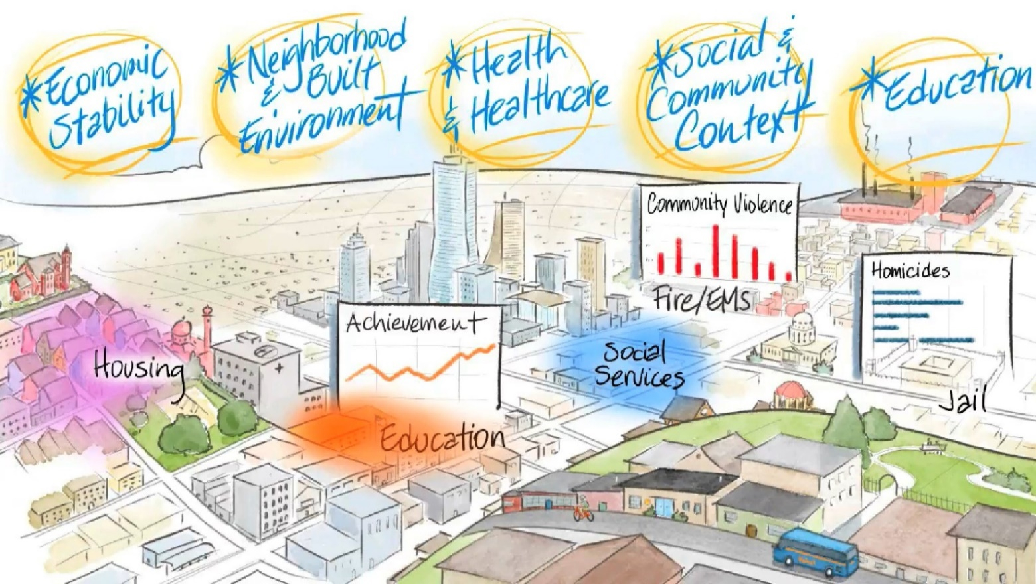
All In projects are rooted in communities

Slide 5
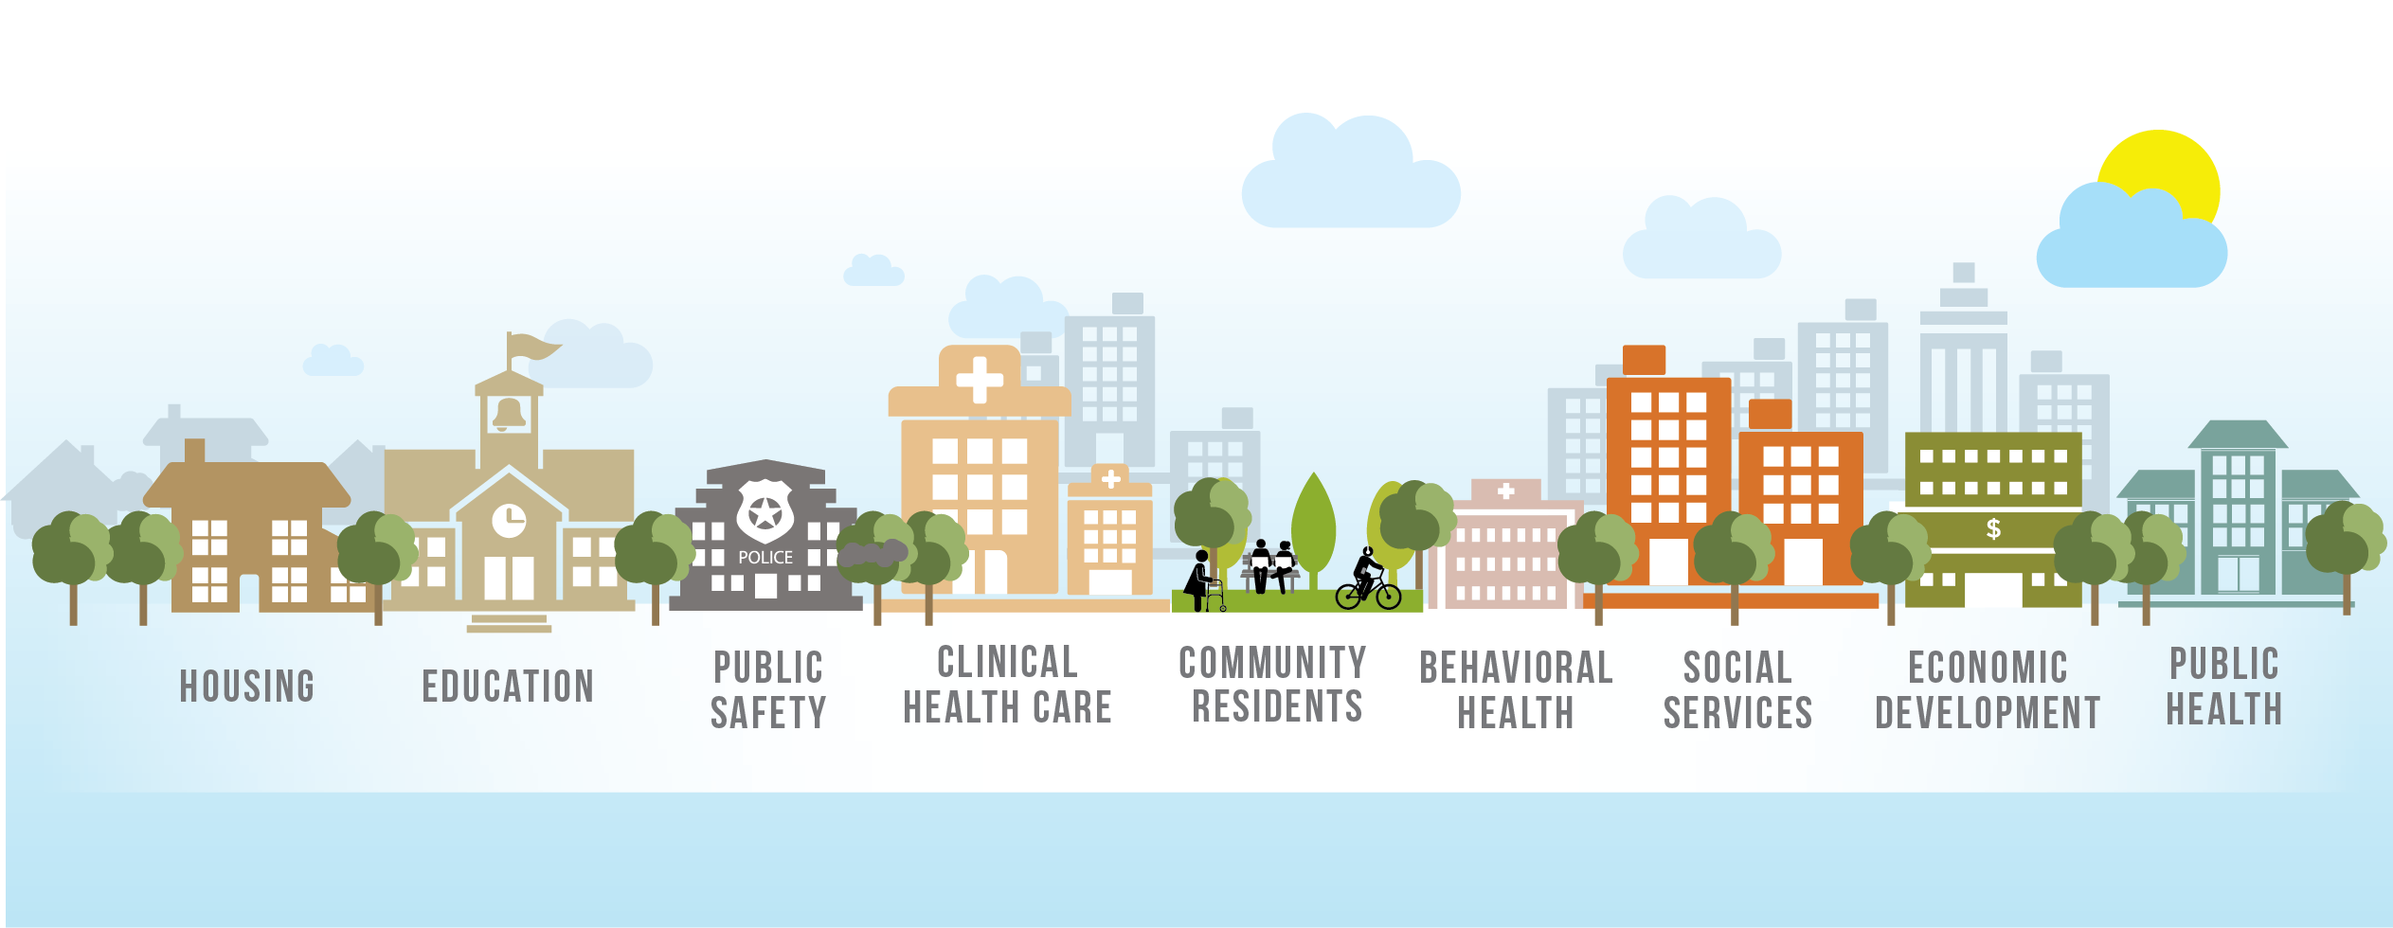
What we talk about when we talk about multi-sector data
Notes:
So, let’s talk about this new field of multi-sector data, give you a couple of examples, and then talk about who we are at All In and how we are trying to build this field.

Slide 6
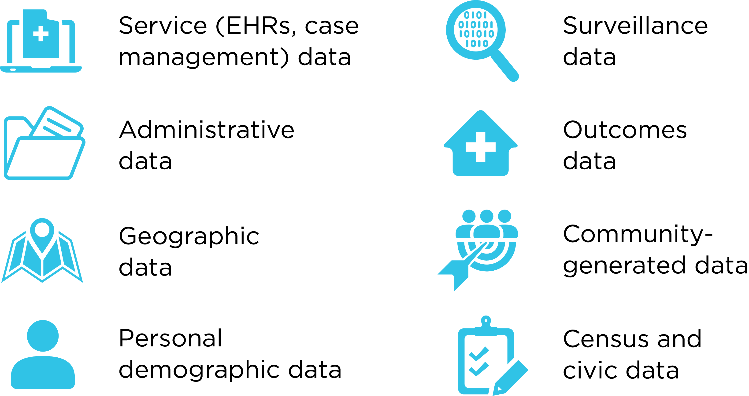
Common Data Types Used
BUILD HEALTH CHALLENGE
Funded by 12 national & local funders
18 graduated implementation and planning grantees
19 new implementation grantees

Slide 7
Two Broad Aims for Data Sharing

Slide 8
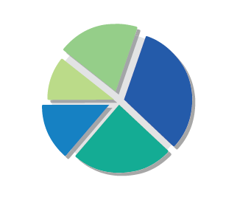
Data Across Sectors for Health (DASH)
Data and Information Sharing
Multi-sector Partners
Outcome:
Capacity Building to Drive Community Health
Improvement
Collaborative Effort

Slide 9
How DASH thinks about developing community collaboration capacity
Collaboration formation (shared value)
System development (shared data)
Intervention design (shared action)
Alignment (shared outcome)
Notes:
Collaboration formation
3 Ps and 3 Ts
Systematic data system development
From shared spreadsheets to deep multi-sector integration
Data-informed interventions
Evaluation and revision
Alignment
Shared fiscal integration

Slide 10
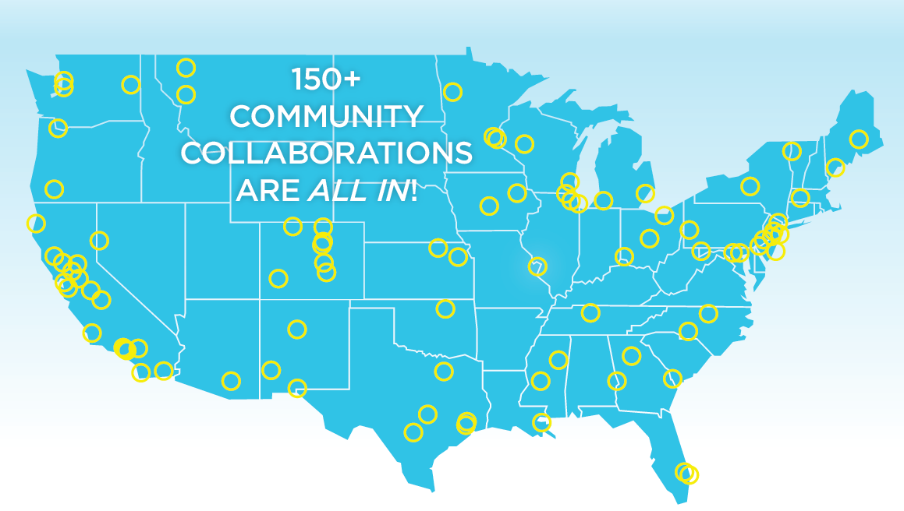
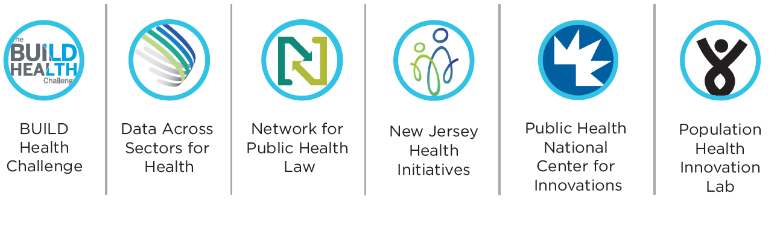
Current Program Partners
Past Partners
Notes:
This is who we are.

Slide 11
All In Partner Mission and Goals
Build community capacity to act
Build the evidence base
Co-create a national “movement”

Slide 12
Building the evidence base – where to find resources
www.DASHconnect.org
www.allindata.org
allin.healthdoers.org

Slide 13
Popular Resources of 2018 - Publications
Health Care Data 101: A guide for non-health care professionals who want to further investigate and leverage the health care data
Bright Spots in Sharing Data for Community Health: profiles highlighting specific and unique aspects of DASH projects
Public Health Innovation Playbook: A website launched by PHNCI to help health organizations succeed in their innovation journeys
BUILD Case Study Series: Healthy Homes Des Moines an effort to treat asthma with healthy housing and the Harris County BUILD Health Partnership work to restructure their local food system
tinyurl.com/AllIn4SCCL

Slide 14
New Resources & Activities in 2019
Value Cases for Data Sharing: Simple introductions to common sectors of interest for multi-sector projects
The Legal Bibliography for Data Sharing: 100+ papers, toolkits and other materials focused on privacy, consent and policies, developed with the Network for Public Health Law
State Policies to Support Community Data Sharing: Practical planning to identify states that are supporting or interested in supporting their local communities to share multi-sector data, including state data
National Snapshot of Data-Sharing Collaborations: A national survey to document the kinds and location of community-focused data sharing projects.

Slide 16
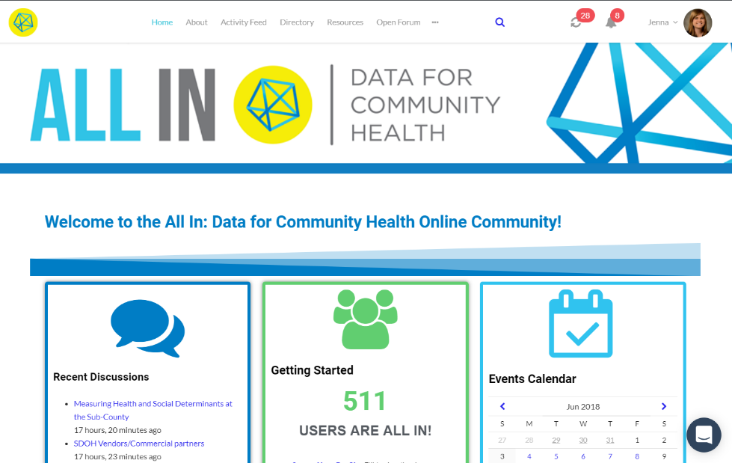
All In Online Community
allin.healthdoers.org
Continue the conversation
Access resources
Connect with peers
Events calendar
Tips to get started:
Complete your individual member profile
Contact info@allindata.org to add a project profile or create your own
Attend an All In Office Hours session for an in-depth tour

Slide 17
Alignment: Built to Last
People in healthcare, public health, and local CBOs/social service organizations:
A shared vision for the future and/or a set of shared goals for what they are trying to do together.
An information system to work together better and share information about people they are helping or measuring/monitoring change together.
A means of payment or financing that enable organizations to work together, especially incentives and accountability for working together.
Collaboration governance or stewardship, with clear roles, responsibilities, expectations and operational and leadership arrangements.

Slide 18
Questions/Discussion
Notes:
18

